Slide 1
PlayArena
Presented by: Harshita, Sohil, Tanuj, Thejasvi

Slide 2
Agenda
Problem Statement
How is this useful?
Explaining Sensor placement & Data recording
Showcasing the sensor data
Data - preprocessing (Code)
Models & plots
Comparison of models and explaining the best one (Results)
TA’s Suggestions
Improvements made
Challenges
Conclusion

Slide 3
Problem Statement(What is our Output?)
Bat tracking (Cricket) in 3D with embedded inertial sensors. Can you also detect the location on the bat where the ball hits?
We plan to predict the kind of shot/response from the player.
Based on time constraint, we also want to locate the point of contact between the bat and the ball.
We will be using IMU sensors in order to find both point 1 and 2.

Slide 4
How is this useful?
Helps analyse the performance of the player.
Helps identifying the right point of contact to make a perfect shot.
Generating 3D simulation helps understand the shot from different angles.

Slide 5
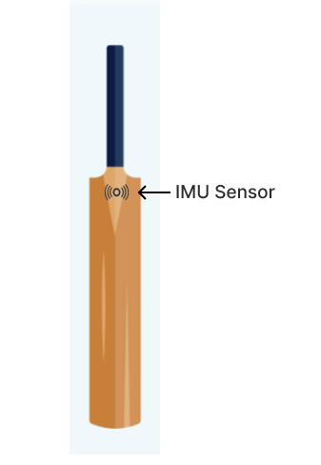
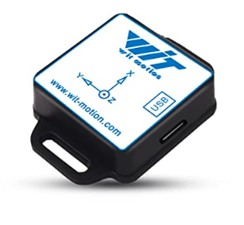
Explaining Sensor placement
We have attached the sensor on the splice of the cricket bat(on the backside).
Why we put it there? Reason : Noise is less as the sensor is closer to the hand of the player.
Notes:
Reason: Angular velocity of hand will almost be identical to that of sensor/ bat

Slide 6
Data recording(About input data)
We have recorded a total of 90 shots which includes different kinds like Attack, Defense and Random shots using IMU sensor and iPhone 13 Mini to record the videos.
Total Number of players: 3
Sequence: 10 Attack Shots, 10 Defense Shots, 10 Random Shots
Total Shots ~ 90
The granularity of the video captured is 60 frames/second
Our ground truth is : Type of the shot(Attack, Defense) and Kind of the shot(Good, Perfect, Early and Late)

Slide 7
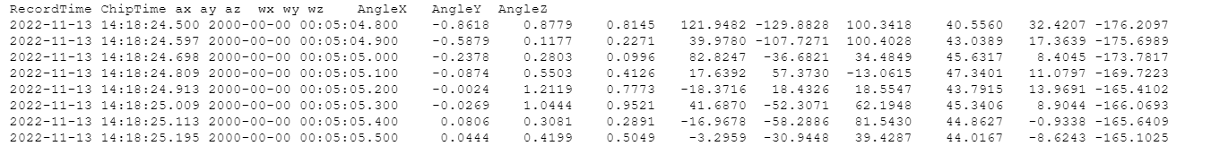
Showcasing the sensor data
We have used IMU Sensor(9-axis) with bluetooth, for the project and recorded accelerometer, magnetometer and gyroscope readings.
The granularity of the data is 0.097 seconds.

Slide 8
Data - preprocessing
Original sensor data was recorded as 2 files but there were 4 videos.
Firstly, we noted down the shot times by playing the video. We considered 2 seconds for the timestamp noted (time of the shot)
Synchronizing these values was our first challenge. We needed to find a way to map these video recordings / shot times to the sensor data recordings.
For this, we split the sensor data into 4 files as per the video start and end timestamps.
For consistency, video data timestamps and sensor data timestamps were converted into seconds.
To match the start times of both, we found the time difference needed for the synchronization. This was subtracted from sensor data. Now, we verified the correctness by matching the peaks in sensor video screen recording to the timestamps of the sensor reading / recorded timestamps from video data.

Slide 9
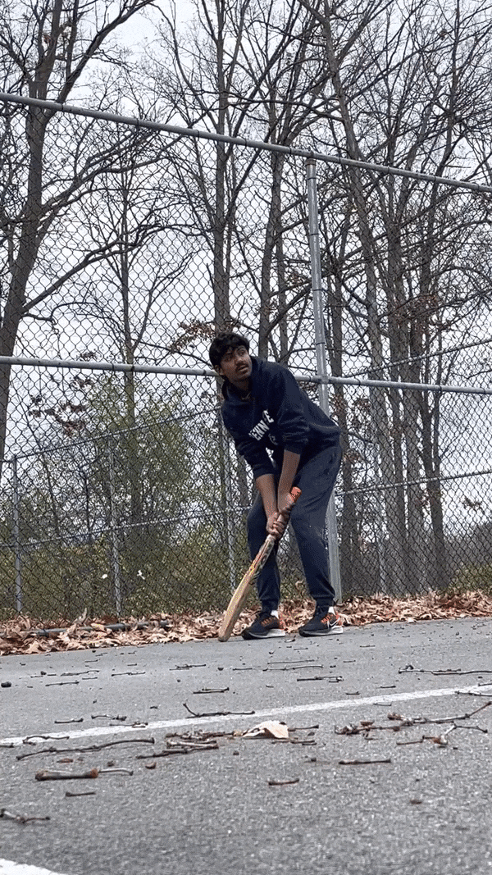
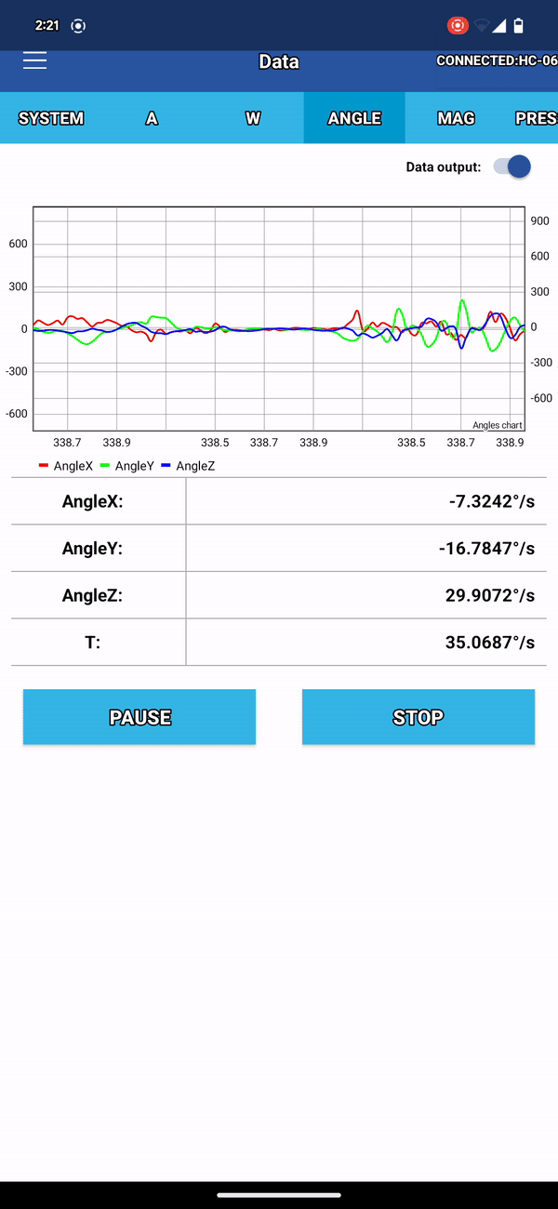

Slide 10
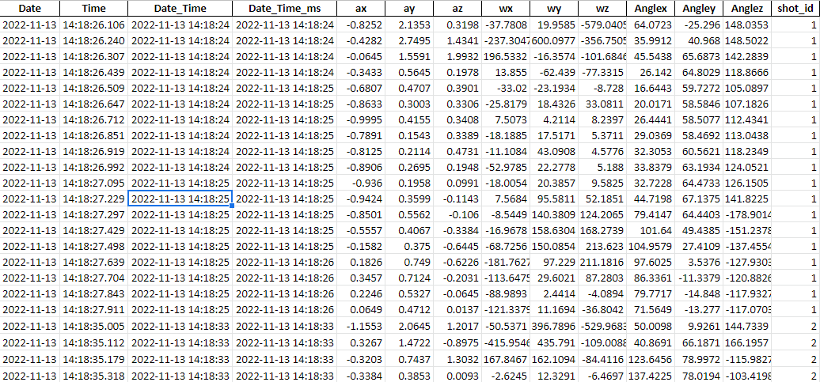

Slide 11
Data Preprocessing Contd.
The next step was to trim the video and sensor timestamp data that corresponded to the shot. For the trimmed data, each shot comprised of about ~10 records from the sensor reading.
Based on type of the shot, we created 2 ground truth labels:
The first one described the shot kind : Early (0),Perfect (1), Good (2) and Late (3)
The second label described the shot type: Attack (1), Defense (0)
We attached the same ground truth for all 10 records. Also, the ShotID is created for each shot so that we have around ~90 unique shots. We did this for the purpose of test/train split and plotting.
The Dataset is now ready!
Notes:
purpose of test/train -> So that we don’t mix up the test and train data.

Slide 12
Results
Model Name | R2_Train_ShotType | R2_Test_ShotType | R2_Train_ShotKind | R2_Test_ShotKind
KNN Classifier | 0.75 | 0.40 | 0.46 | 0.34
SVC | 0.83 | 0.54 | 0.50 | 0.35
KMeans | 0.75 | 0.41 | 0.25 | 0.25
RFClassifier | 1.0 | 0.63 | 1.0 | 0.32
XGBoost Classifier | 0.95 | 0.60 | 0.82 | 0.31
ExtraTreesClassifier | 0.85 | 0.54 | 0.58 | 0.33
MLP | 0.85 | 0.60 | 0.54 | 0.31
Notes:
Type: Def / Attack
Kind: Good/Late etc

Slide 13
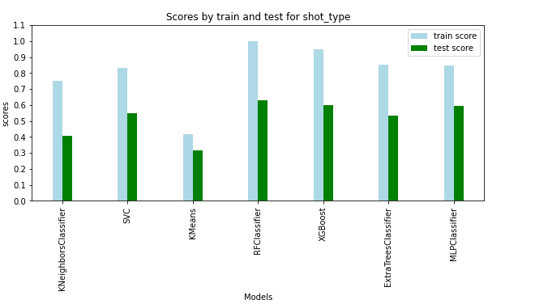
Comparison of models and explaining the best one

Slide 14
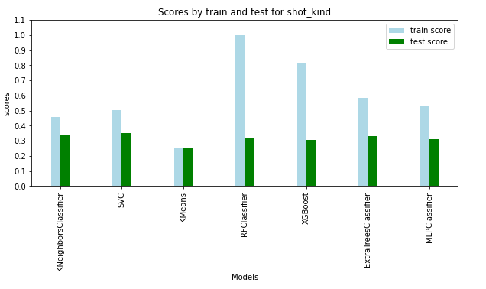
Comparison of models and explaining the best one

Slide 15
TA’s Suggestions / Feedback
Finding a way to separate out Test and Train data
Time series data models. MLP, LSTM
Improvements after Feedback
Train and test sets are completely independent now as it’s supposed to be.
Added MLP Classifier model and removed the regression models(because of bad scores)
We have also added 2 new classification models to improve R2 score

Slide 16
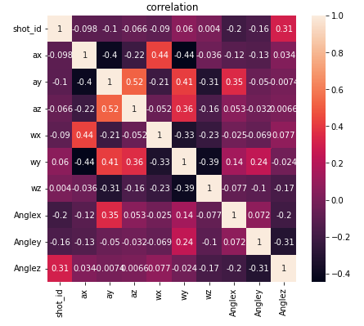
Correlation

Slide 17
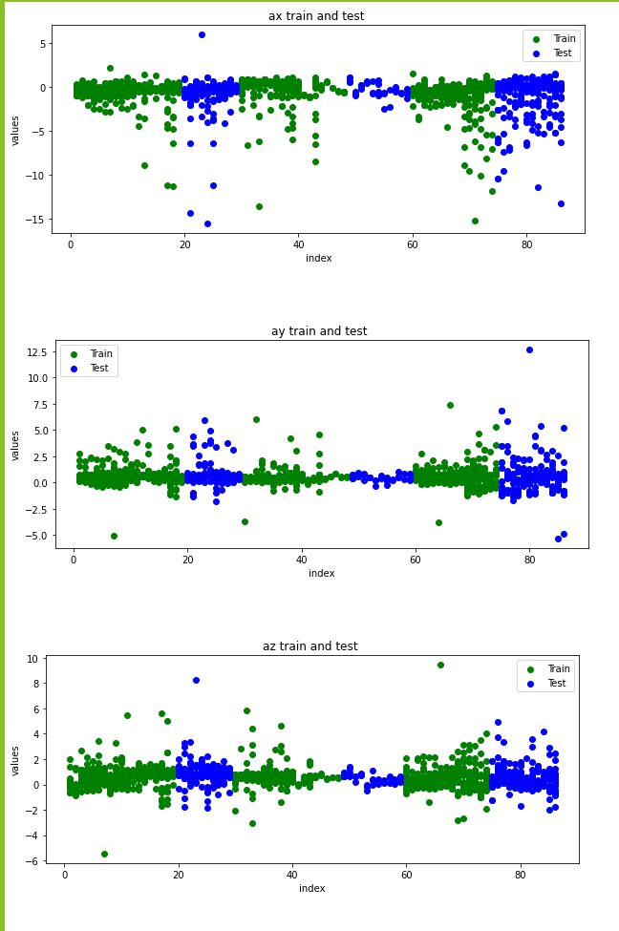
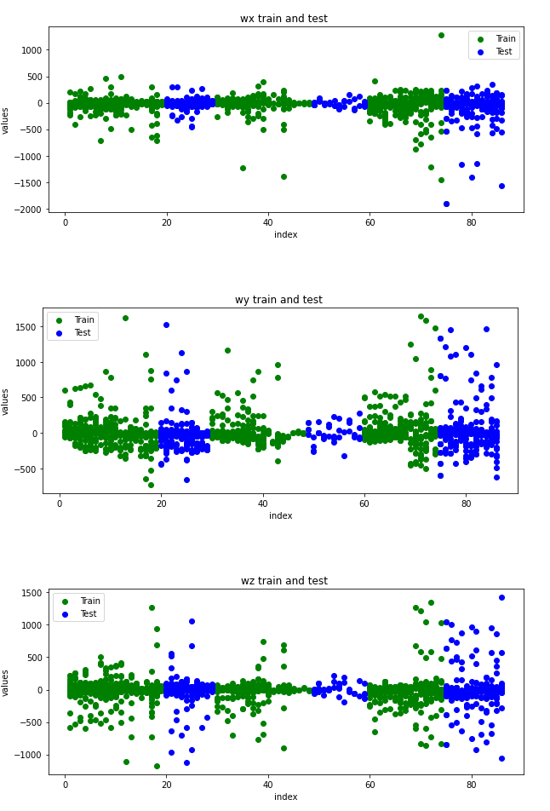
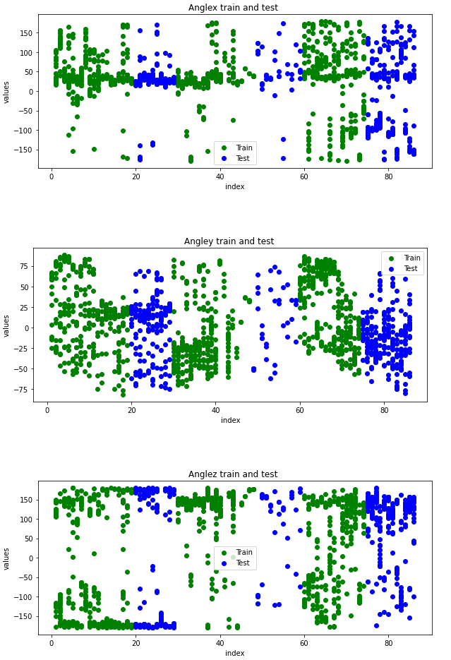
Feature Plots

Slide 18
Challenges
Data Preprocessing
Ground Truth Mapping
Code Reusability
Hyper Parameter Tuning
Bad weather to play cricket

Slide 19
Conclusion
What went well?
What didn’t go well?
Future Works
Different models works well similarly on both the ground truths
Clean analysis of feature plots with respect of input
Even distribution of attack/defense ground truth
Uneven split of shot kind was giving a bad result for the prediction. Each player’s gameplay is different and this made it difficult.
Initial calculation for correlating time wrt video and sensor data, data splitting
LSTM
Hyper parameter tuning and better distributed data splits
Notes:
Didn’t go well? Many hiccups during data preprocessing steps.

